Slide 1
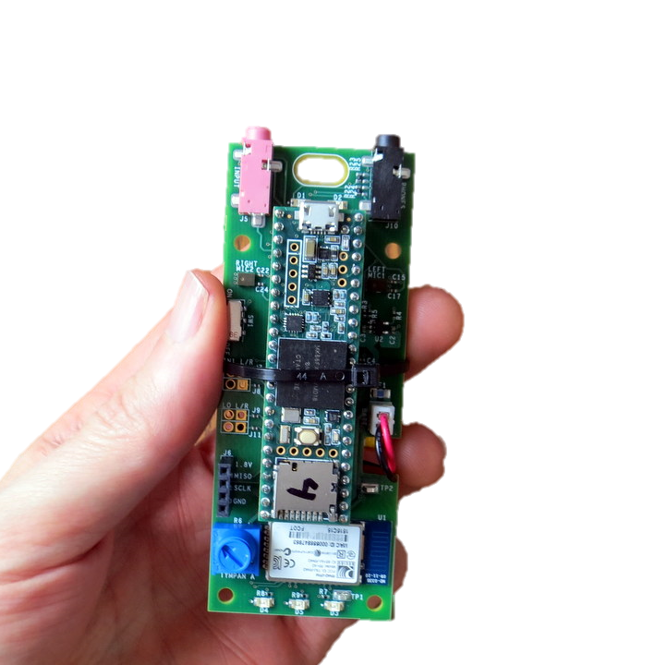
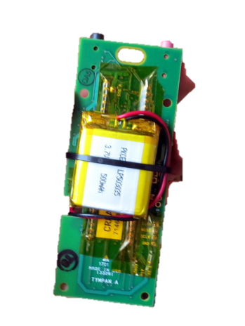
Tympan Rev A/C Hardware
USB to
Program/Recharge
Line-In / Mic Jack
Headphone Jack
On-Board Mic
On-Board Mic
Power
Switch
Li-Po Battery on Back
Bluetooth
Classic
User Pot
(Volume)
User
LEDs

Slide 2
Tympan Rev E, Goals
Goals:
Primary Goal: Smaller
Secondary Goals: Lower cost, more attractive, BLE, better microphones
Approach:
Integrate Teensy into Tympan Board, Swap BT Module, Shrink PCB Size, Possibly Change Mics
Unknowns: Which BLE Module, Which Mics

Slide 3
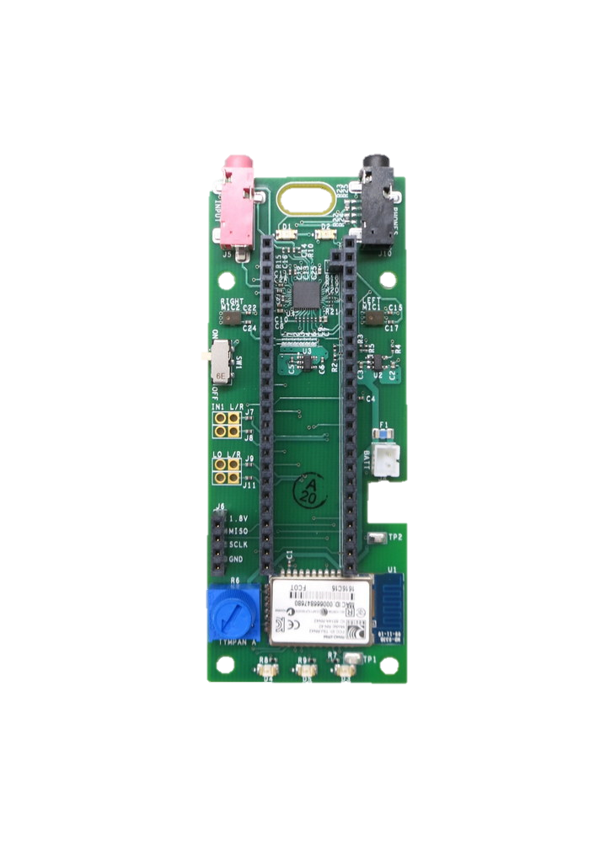
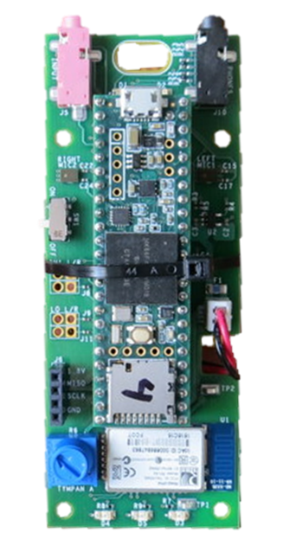
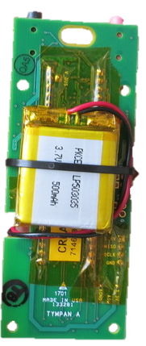
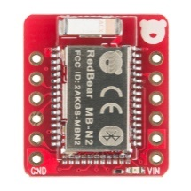
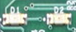
Tympan Rev E Ideas
Li-Ion Battery: (add extra room for wires)
Adafruit: 500 mA-hr: 29 x 36 x 4.76 mm
Sparkfun: 400 mA-hr: 26.5 x 36.9 x 5 mm
Li-Ion Battery: (add extra room for wires)
Adafruit: 500 mA-hr: 1.15 x 1.4 x 0.19”
Sparkfun: 400 mA-hr: 1.06 x 1.48 x 0.2”
battery

Slide 4
Tympan Rev E Ideas
Li-Ion Battery: (add extra room for wires)
Adafruit: 500 mA-hr: 29 x 36 x 4.76 mm
Sparkfun: 400 mA-hr: 26.5 x 36.9 x 5 mm
Li-Ion Battery: (add extra room for wires)
Adafruit: 500 mA-hr: 1.15 x 1.4 x 0.19”
Sparkfun: 400 mA-hr: 1.06 x 1.48 x 0.2”
battery
Top
Top

Slide 6
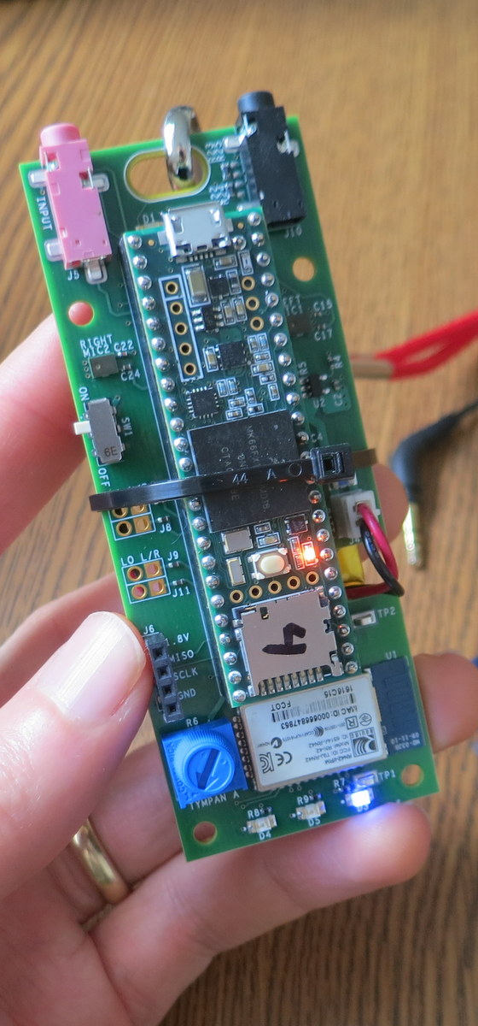
Hardware Specs
Processor
NXP MK66F (ARM Cortex M4F Core)
180 MHz with Floating-Point Unit
Analog-Digital
Texas Instruments TLV320AIC3106, stereo ADC and DAC
32/24/20/16-bit configurable (93 dB SNR)
Low-noise, software-controllable gain on inputs
Software-controllable microphone bias
Software-controllable headphone amplifier
Data Interfaces
USB Serial, USB Audio, USB HID
Bluetooth Classic
SD Card
Digital microphone port
Power
Draws about 100 mA @ 3.7V.
Power from USB or Li-Po Battery
On-board recharging from USB (with indicators)
Programming
Reprogram via USB. Program in C/C++.
Free, open-source toolchain
User Interaction
Potentiometer, LEDs, Bluetooth

